Slide 1

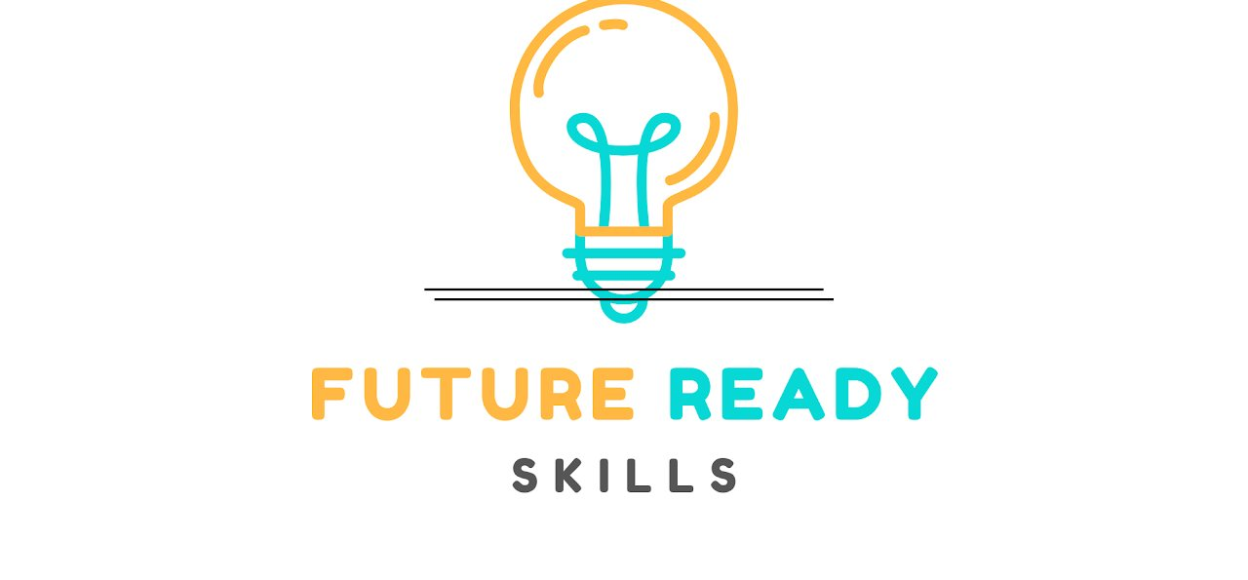
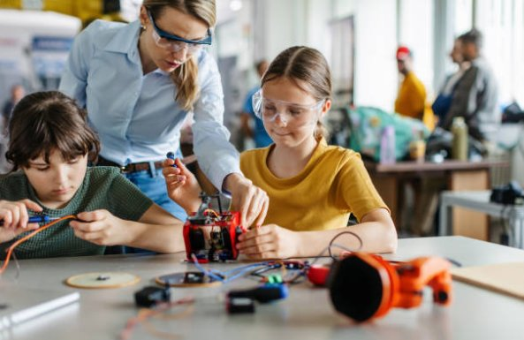
TWO RIVERS SCHOOLS NETWORK · FOUNDATION TO YEAR 10
Future Ready Skills Academy
inspire
All contents, © Government of Western Australia 2026, unless otherwise stated

Slide 2
Our learning goals today
1
Understand the five Future Ready Skills (FRS), their curriculum links and this SE Metro school priority project
2
Explore where the FRS progressions came from and what they are for
3
Identify practical strategies for using the FRS in the classroom
4
Find FRS support and training resources
Future Ready Skills Academy · frs.srczone.net
2 / 17
Notes:
All presenters introduce themselves, with a quick explanation of their role.
Depending on the session, also ask participants to introduce themselves, including where they work and in what role.

Slide 3
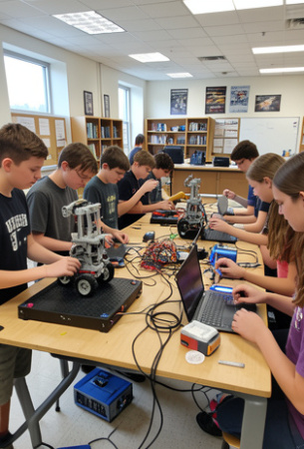
OUR STORY AND ORIGIN
From Robotics Clubs to whole-school pedagogy
Where it began. Australian Schools Plus supported the development of Robotics Clubs in Gosnells, Western Australia.
What we learned. Success in competitions showed that students need specific soft skills, not just technical knowledge.
What we built. Tracking how students developed these skills led us to create resources.
Where we are now. The framework is now a whole-school pedagogy across the district.
Future Ready Skills Academy · frs.srczone.net
3 / 17
Notes:
Gosnells Robotics Clubs (GRC) began when Southern River College and Thornlie SHS applied for a Schools Plus grant. It is a 3-year project to increase robotics participation in the high schools' feeder primary schools, and 8 feeder primary schools are currently involved.
One of the first things we decided was that we needed a common language, so that we and our students knew what the skills were. We developed our own version of the Future Ready Skills, which we call the 5Cs.

Slide 4






Why teach Future Ready Skills?
The world is changing fast. We don't really know what the future workforce will look like.
The specific skills students will need are hard to predict.
Students need skills that help them stay flexible and adapt to changing environments.
These skills don't come naturally to everyone, so they need to be taught.
Many students are good at the 'doing', but not the 'thinking'.
If students don't understand the skills, they won't transfer them to other areas.
Future Ready Skills Academy · frs.srczone.net
4 / 17
Notes:
Many of us run great STEM activities, including our robotics clubs. These programs DO engage students with design thinking, the Technologies curriculum and the world of STEM. What they don't do automatically is get students to think metacognitively about the skills and thinking they are learning, so students don't transfer that learning to other subjects.
In practice, students focus on doing the robotics and producing a product. Unless we draw it out explicitly through our structures and pedagogy, they don't reflect on or work on the process they use to produce that product (whatever it is). Focusing on improving the process and the thinking leads to sustainably higher-quality products. Teachers often deliver STEM learning with a focus on the product, not the process.
Developing Future Ready learners means creating structures and using pedagogy that develop students' thinking and approaches, so they can be flexible and adaptable whatever they face. We must nurture the 5Cs and help students transfer them across subjects and disciplines. Our upper-quartile learners often do this themselves, but the rest don't.

Slide 5
What are Future Ready Skills?
Future Ready Skills blend cognitive and interpersonal abilities, preparing students for a dynamic society.
They align with the Australian Curriculum General Capabilities and with government and industry priorities.
Community means understanding culture
We added Community to the well-known 4Cs because understanding and connecting with people and culture is an essential part of 21st-century learning.
Community
Communication
Collaboration
Critical Thinking
Creativity
Future Ready Skills Academy · frs.srczone.net
5 / 17
Notes:
We looked at the new Australian Curriculum (Version 9.0), which has a Critical and Creative Thinking learning continuum. Its statements aligned well with our 5Cs, so we cut them up and matched them to the different skills at each year level, from Foundation right through to Year 10.

Slide 6
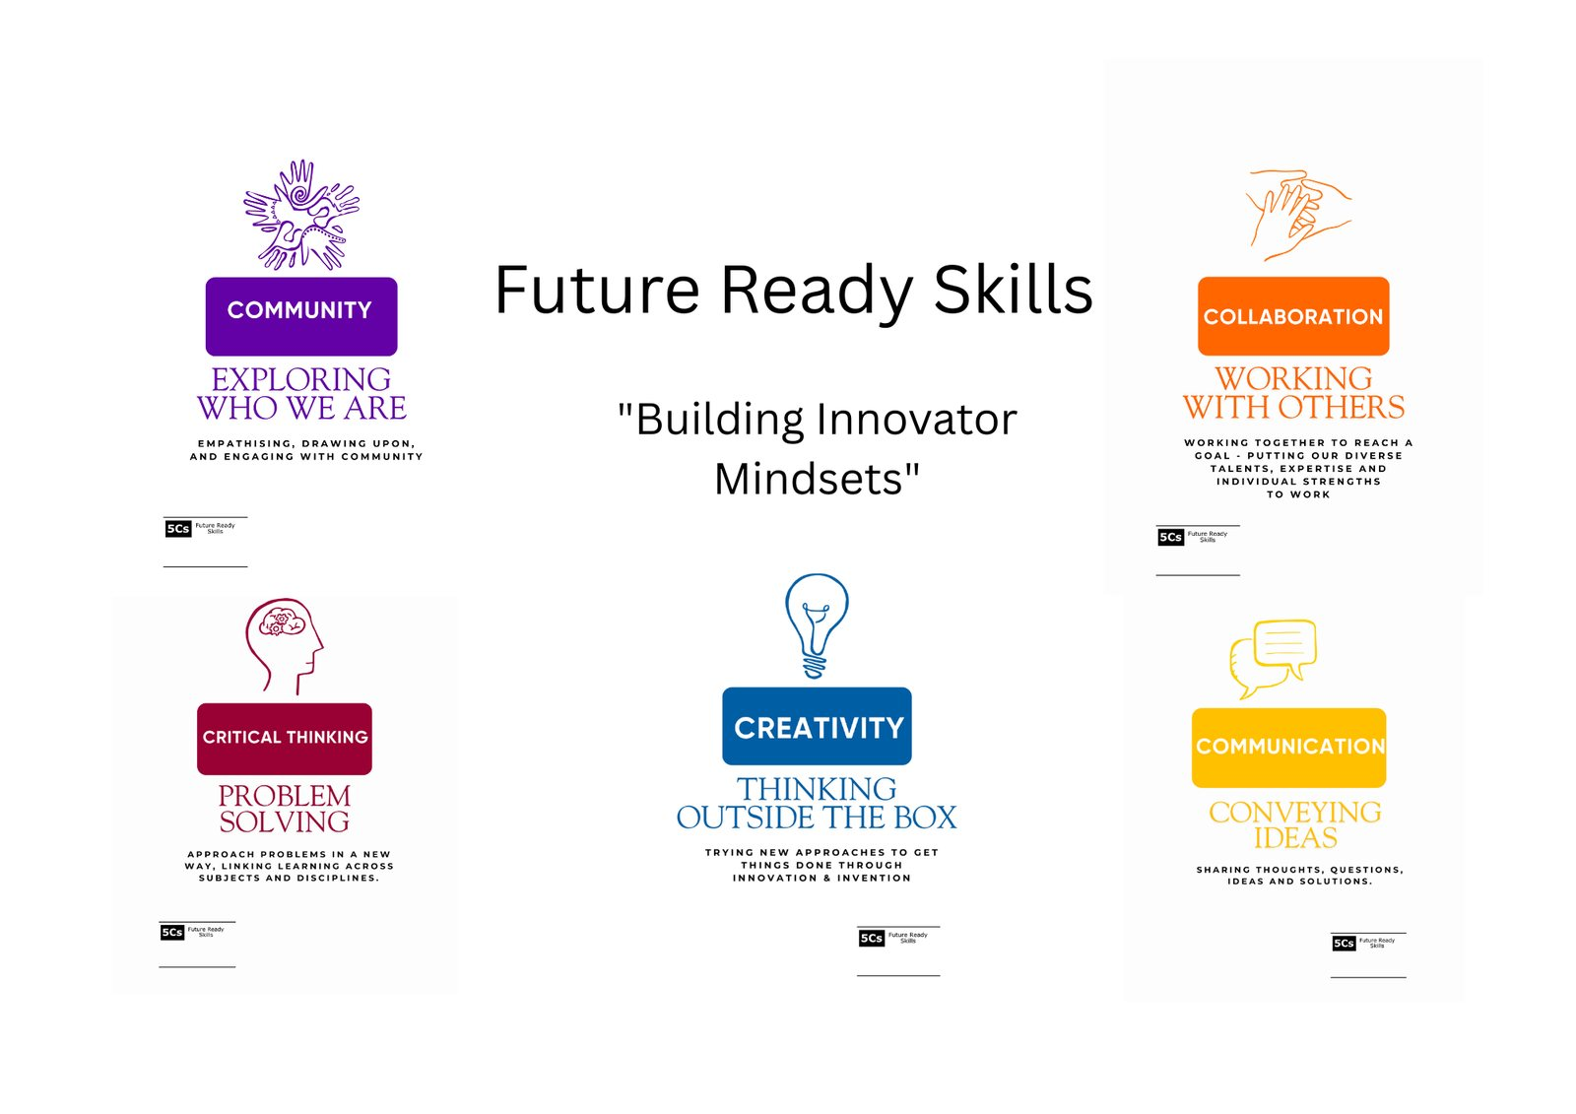
The 5Cs
Building Innovator Mindsets
Community
Communication
Collaboration
Critical Thinking
Creativity
6 / 17
Notes:
These are the Future Ready Skills, or 5Cs, that we decided on: Community (exploring who we are), Communication (conveying ideas), Collaboration (working with others), Critical Thinking (problem solving) and Creativity (thinking outside the box).

Slide 7
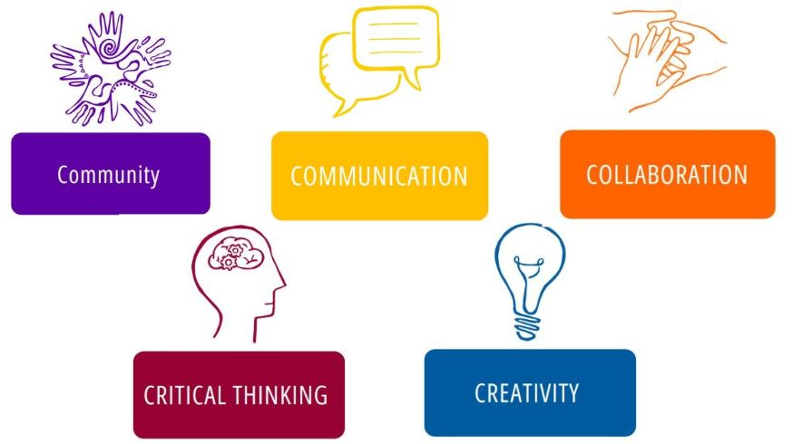
THINK · PAIR · SHARE
Discuss
Think about a recent lesson you taught. Which of the 5Cs did your students practise most effectively?
How did you observe this?
Future Ready Skills Academy · frs.srczone.net
7 / 17
Notes:
Think, pair, share: reflection.
Depending on the session, this is a good time for an activity. For example, divide the group into 5 groups. Give each group a container of LEGO and one of the 5Cs. Each group uses the LEGO to build a model that represents their skill, completes the activity sheet, and presents their model to everyone, explaining how it represents the skill.

Slide 8

You might have said…
Group work: assigning roles
Collaboration
Debates and presentations
Communication
Problem-solving: fixing bugs
Critical Thinking
Art and design
Creativity
Local history and environment
Community engagement
Future Ready Skills Academy · frs.srczone.net
8 / 17
Notes:
These are some of the ways the Future Ready Skills apply across other areas of the curriculum.

Slide 9
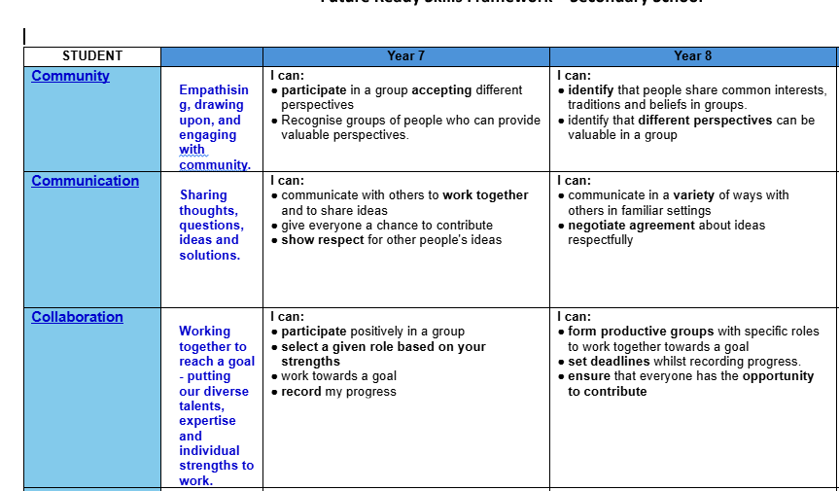


How the progressions work
Tracking growth
The resources on frs.srczone.net help teachers from Foundation to Year 10 teach and record students' progress in each skill.
The structure
The progressions describe the small steps students take as they develop each skill. Bold text marks a new focus or element at that stage of learning.
Future Ready Skills Academy · frs.srczone.net
9 / 17
Notes:
We took the statements from ACARA and condensed them into the relevant skills. From these, we wrote Teacher and Student statements describing the skills that should be evident at each year level. Our framework tracks student progress from Foundation through to Year 10. You have copies of the whole framework to keep and use.

Slide 10


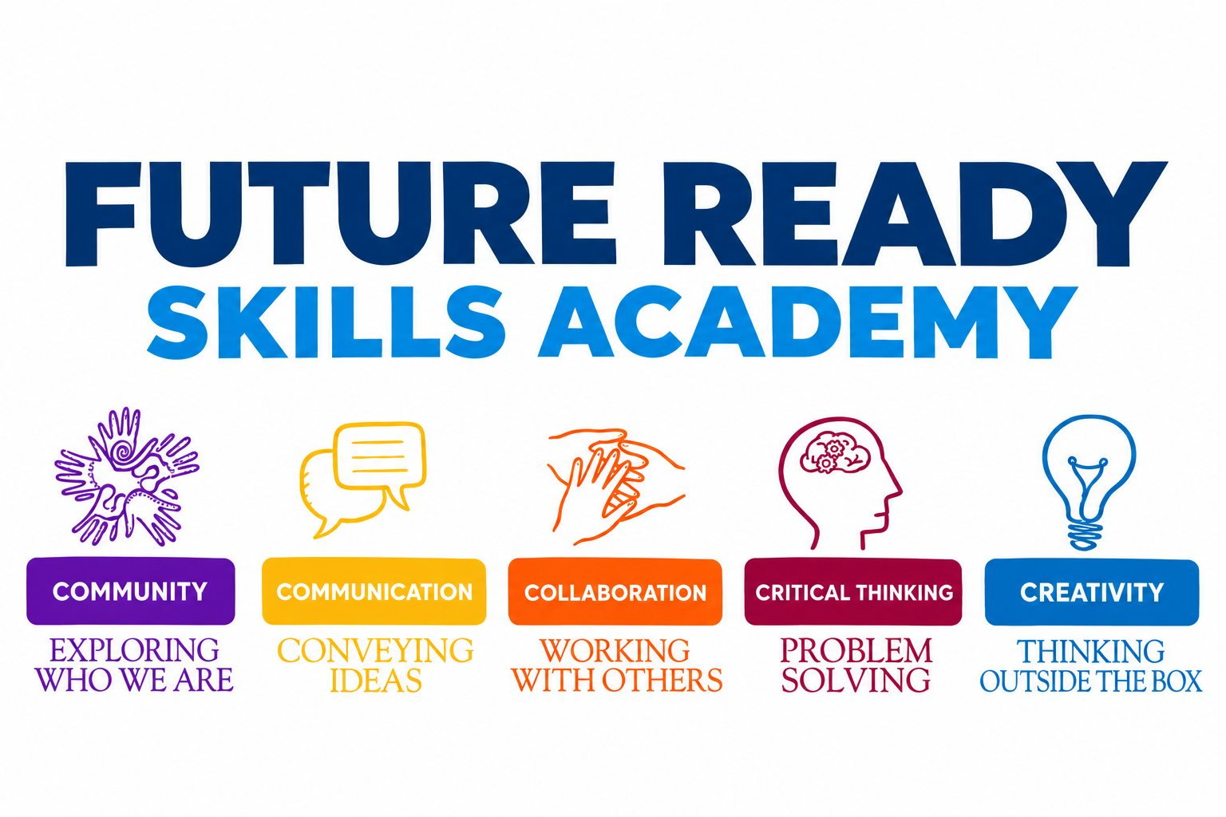
FUTURE READY SKILLS ACADEMY
Where to next?
Inspire · Aspire · Engage
10 / 17
Notes:
Where to next?
We are currently at the end of our 3-year Schools Plus project. We hope to continue with another 3-year Schools Plus partnership, which would provide funding, coaching, program management, evaluation and scaling support.
We have developed the Future Ready Skills Academy:
- It is built around Inspire–Aspire–Engage: inspire STEM interest, help students aspire to STEM futures, and engage them with real-world STEM experiences and career pathways.
- The aim is a connected STEM and Future Ready Skills ecosystem, linking primary and secondary schools, in which every participating school can access the expertise, learning experiences and pathways available across the network.
- It is a partnership between 13 low-ICSEA schools: Southern River College, Thornlie SHS, South Thornlie PS, Yale PS, Ashburton Drive PS, Huntingdale PS, Gosnells PS, Wirrabirra PS and Seaforth PS, plus four new regional and remote schools: Kalgoorlie Boulder Community High School, Newman SHS, Marble Bar PS and Eaton Community College.
Proposed partners:
- Google: technology platform, cloud capability, digital technologies, and potential sponsorship or technical partnership.
- Murdoch University: STEM outreach, teacher education, research, and potential co-design and accreditation of micro-credentials.
- Fogarty Foundation: Future Ready Students, teacher capability, STEM, and regional education engagement.
- Industry partners: experts, mentors, authentic projects, equipment, workplace exposure and career pathways.

Slide 11
Inspire · Aspire · Engage
A connected network of schools, teachers, universities, industry and education foundations. Bringing the expertise to students, instead of students travelling to the expertise.
INSPIRE
ASPIRE
ENGAGE
Meet STEM as exciting and accessible through robotics, AI, engineering, coding, cybersecurity, sustainability, design challenges and STEM professionals.
Discover the breadth of STEM careers and the pathways through school, TAFE, university, apprenticeships and industry, guided by role models.
Work on real community and industry problems with mentors, university programs, competitions and workplace experiences.
Could STEM be something I'm interested in?
Could I have a future in STEM?
How can I use STEM to make a difference?
INSPIRE
→
ASPIRE
→
ENGAGE
Future Ready Skills Academy · frs.srczone.net
11 / 17
Notes:
The Future Ready Skills Academy grows out of the Gosnells Robotics Clubs work and the 5Cs. It is a connected network of schools, teachers, universities, industry and education foundations for Foundation to Year 10, built around Future Ready Skills, Two-way Science, entrepreneurship, STEM, emerging technologies and real career pathways.
Walk through the three stages. Inspire: students meet STEM as exciting and accessible. Aspire: they discover STEM careers and pathways through school, TAFE, university, apprenticeships and industry, guided by role models. Engage: they work on real community and industry problems with mentors, university programs, competitions and workplace experiences, building a portfolio of evidence and pathways into further study and STEM careers.
The big idea: bringing the expertise to students, instead of students travelling to the expertise.

Slide 12

13 schools, one Virtual Academy
13
The Virtual Academy
Building lasting capability
A specialist teacher at one school can teach students across several Academy schools.
Year 1 External experts and partners lead experiences while Lead Teachers build capability.
ACADEMY SCHOOLS
University academics and industry experts reach many schools without repeated travel.
9 metropolitan schools in the Gosnells area, with Southern River College as Lead School
Year 2 Lead Teachers mentor colleagues and pre-service teachers and deliver professional learning.
Regional schools join specialist experiences without the full cost of travel.
4 regional: Kalgoorlie Boulder CHS, Newman SHS, Marble Bar PS and Eaton Community College
Year 3 Experienced teachers train and mentor new schools as the Academy grows.
One expert lesson can inspire hundreds of students across the network.
Future Ready Skills Academy · frs.srczone.net
12 / 17
Notes:
The Academy network has 13 schools: 9 metropolitan schools in the Gosnells area (Southern River College as Lead School, Thornlie SHS, South Thornlie PS, Yale PS, Huntingdale PS, Ashburton Drive PS, Gosnells PS, Wirrabirra PS and Seaforth PS) and 4 regional schools (Kalgoorlie Boulder Community High School, Newman SHS, Marble Bar PS and Eaton Community College).
The Virtual Academy brings expertise to students: specialist teachers, university academics and industry experts can reach many schools at once. Virtual sessions complement, not replace, hands-on visits, and approved recordings become reusable Academy resources.
Capability is built over three years so the Academy becomes self-sustaining: experts lead in Year 1, Lead Teachers mentor colleagues in Year 2, and experienced teachers train new schools in Year 3.
Partnerships with organisations such as Google, Murdoch University and the Fogarty Foundation are proposed opportunities for discussion, not existing commitments. Schools interested in joining can submit an Expression of Interest through the Academy App.

Slide 13




The Academy App: plan a report in six questions
AI learning plan
Intentions & criteria
Curriculum links
Unit overview, key questions and a 4–6 lesson sequence, labelled as AI-assisted and checked by you.
Learning intentions for the year level, with editable "I can" success criteria for your chosen skills.
WA Curriculum strand links, YEAWA entrepreneurial skills and WA STEM Learning Project modules.
Slides & prompts
Experts & partners
Student surveys
Create a slide deck from your plan, or copy a lesson prompt for Chalkie and other AI tools.
Request a guest talk, site visit or competition help from experts and industry partners who opt in.
Run start and end FRS surveys on a classroom device or students' own devices. No names are stored.
Future Ready Skills Academy · frs.srczone.net
13 / 17
Notes:
The Future Ready Skills Academy App links emerging technology to the classroom. In Plan a report, teachers answer six questions: what students learn about, year level, what students will do, resources and technologies, curriculum goals, and a learning intention (tick the 1–2 Future Ready Skills you want to focus on).
The report includes an AI-assisted learning plan (or a standard version where AI isn't available), learning intentions with editable "I can" success criteria, WA Curriculum strand links, the Future Ready Skills progression for the year, linked YEAWA entrepreneurial skills, WA STEM Learning Project modules and other classroom resources.
From the report, teachers can create a slide deck, copy a lesson prompt for Chalkie or another AI tool, request an expert or industry partner, see upcoming competitions and events, and run an FRS student survey at the start and end of the learning. AI-written plans are labelled, and teachers tick "I've checked this plan" before using them.
Demo: if time allows, open the App and plan a quick report together.

Slide 14




One App for everyone
Teachers
School Leaders
Partners & experts
Everyone
Plan reports, share your expertise in the directory, request experts and run student surveys.
A School console with reports, topics, FRS focus and survey results, plus printable summaries.
Offer guest talks, site visits, competition help or sponsorship, and answer teacher requests.
The FRS framework, resources, Academy Schools, a competitions and events calendar, and Help.
Privacy and AI by design
Get started
Contact details only for confirmed members, no student names in surveys, and AI plans labelled and checked by teachers.
Go to frs.srczone.net and choose your role. Use the Help and Feedback buttons on every page, or email frsadmin@srczone.net.
Future Ready Skills Academy · frs.srczone.net
14 / 17
Notes:
The App serves the whole Academy community, with a view for each role.
Teachers plan learning reports, can list their expertise in the Experts and partners directory, request experts and industry partners, and run FRS student surveys.
School Leaders (approved by Academy Admin) get a School console for their own school: active teachers, curriculum reports, topics explored, Future Ready Skills focus, start and end survey results, and printable summaries.
Industry partners and experts register their offerings (guest speaker, site visit, volunteers for competitions, sponsorship) and answer teacher requests.
Everyone can use the FRS framework, resources, the Academy Schools page, the calendar of competitions and events on WA school terms, and Help.
Privacy and safety are built in: contact details only for confirmed members, anonymous student survey results, and AI-written plans clearly labelled and checked by teachers. See "How the Academy uses AI" in the App footer.
To get started, go to frs.srczone.net and choose your role. The Help (?) and Feedback buttons are at the bottom right of every page. Questions: frsadmin@srczone.net.

Slide 15

Student surveys
Run the survey after teaching a group what the Future Ready Skills are at the start of a year, semester or term. Survey again after reinforcement lessons in that period, so you have pre and post results.
Data is collected at Southern River College and shared with you as an Excel spreadsheet. Filter by your name or school to see your students' or school's results. The data will also be visualised, summarised and emailed to you.
PRE
After teaching what the Future Ready Skills are
POST
After reinforcement lessons in that period
Student surveys link →
Future Ready Skills Academy · frs.srczone.net
15 / 17
Notes:
We have developed a series of surveys to help us monitor how effective the 5Cs are, and they are available for you to use. Our website also has a range of activities that help students build their 5Cs skills; these are activities we have been using in our own classes. The website is a work in progress and is added to all the time.

Slide 16
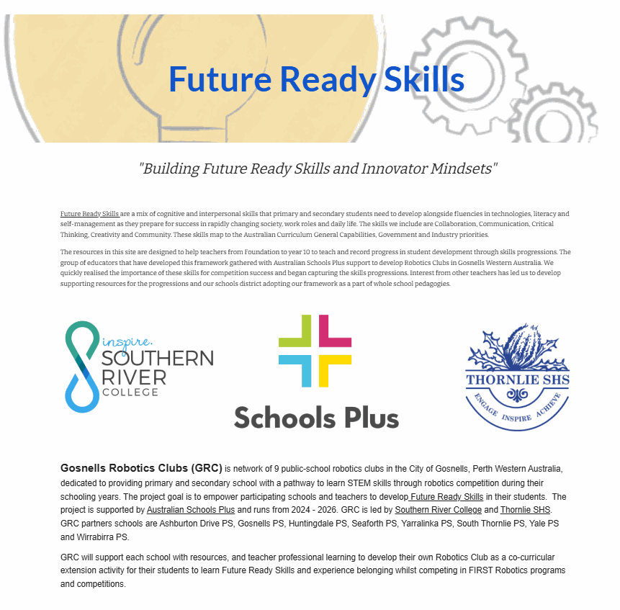
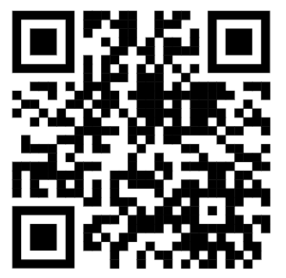
Resources
Downloads
Contact the Two Rivers Network FRS Coordinator
FRS progression statements
Teacher PL presentations
Southern River College
Class FRS skills presentations
john.townley@education.wa.edu.au
larissa.waghorn@education.wa.edu.au
Library of FRS teaching resources
Student surveys
frs.srczone.net
Gosnells Robotics Clubs: grc.srczone.net
Future Ready Skills Academy · frs.srczone.net
16 / 17
Notes:
Now show the website and give a quick demo of some of its features.

Slide 17

Learning goals and summary
Our goals today
Understand the five Future Ready Skills (FRS), their curriculum links and this SE Metro school priority project
Explore where the FRS progressions came from and what they are for
Identify practical strategies for using the FRS in the classroom
Find FRS support and training resources
Summary
Future Ready Skills are vital for student success. The FRS progressions help us support and monitor students' development in Community, Communication, Collaboration, Critical Thinking and Creativity.
Future Ready Skills Academy · frs.srczone.net
17 / 17

